Slide 1










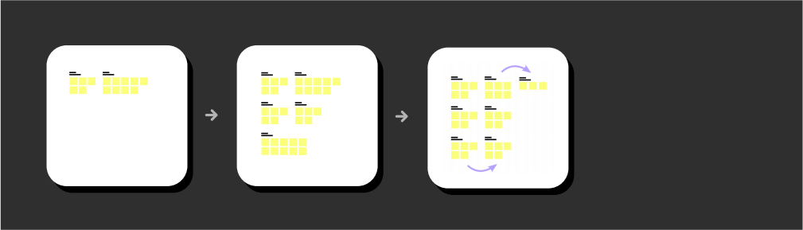
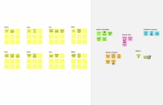
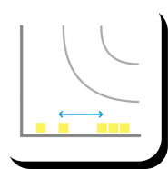

 | Brainstorm & idea prioritization Use this template in your own brainstorming sessions so your team can unleash their imagination and start shaping concepts even if you're not sitting in the same room. 10 minutes to prepare 1 hour to collaborate 2-8 people recommended | Before you collaborate A little bit of preparation goes a long way with this session. Here’s what you need to do to get going. 10 minutes Team gathering Defne who should participate in the session and send an invite. Share relevant information or pre-work ahead.
 |  |  | Set the goal Think about the problem you'll be focusing on solving in the brainstorming session.
 |  |  | Learn how to use the facilitation tools Use the Facilitation Superpowers to run a happy and productive session. Open article
Need some inspiration? See a fnished version of this template to kickstart your work. Open example
3
Group ideas Take turns sharing your ideas while clustering similar or related notes as you go. Once all sticky notes have been grouped, give each cluster a sentence-like label. If a cluster is bigger than six sticky notes, try and see if you and break it up into smaller sub-groups. 20 minutes | TIP Add customizable tags to sticky notes to make it easier tofnd, browse, organize, and categorize important ideas as themes within your mural.
4 Prioritize Your team should all be on the same page about what's important moving forward. Place your ideas on this grid to determine which ideas are important and which are feasible. 20 minutes |  |  | TIP Participants can use their cursors to point at where sticky notes should go on the grid. The facilitator can confrm the spot by using the laser pointer holding the H key on the keyboard. | After you collaborate You can export the mural as an image or pdf to share with members of your company who might fnd it helpful. Quick add-ons
+ Importance If each of these tasks could get done without any difculty or cost, which would have the most positive impact? - | Feasibility Regardless of their importance, which tasks are more feasible than others? (Cost, time, effort, complexity, etc.)
 |  |  |  |  | Share the mural Share a view link to the mural with stakeholders to keep them in the loop about the outcomes of the session. Export the mural Export a copy of the mural as a PNG or PDF to attach to emails, include in slides, or save in your drive.
 |  |  |  | Keep moving forward
 |  |  |  |  |  | Strategy blueprint Defne the components of a new idea or strategy. Customer experience journey map Understand customer needs, motivations, and obstacles for an experience. Open the template Strengths, weaknesses, opportunities & threats Identify strengths, weaknesses, opportunities, and threats (SWOT) to develop a plan. Open the template
 |  |  |  | Share template feedback
1
2
Defne your problem statement
What problem are you trying to solve? Frame your
problem as a How Might We statement. This will be the focus of your brainstorm.
5 minutes
Brainstorm Write down any ideas that come to mind that address your problem statement. 10 minutes | TIP You can select a sticky note and hit the pencil [switch to sketch] icon to start drawing!
A
PROBLEM
Patients want better health
technology in hospitals.
Hospitals are under
pressure to digital transform.
Care providers and staff are
experiencing high rates of
Person 1 |  |  | Person 2 |  |  | Person 3 |  |  | Person 4
A
The Hight cost of
Health
Care.
The
concerns of
Health
equity.
The Promise
(and Pitfalls)
of
Technology.
The move
towards
Value-
Based Care.
The
Growing Provider Shortage.
Insufciency
of Hospital
beds.
Less
number of
Health Care
centres.
Insufcient
number of
blood
banks.
Urgent need for more medical colleges.
Non-
availability of
Urgently
Needed
Vaccine.
Need of government Health care schemes.
Need of
NGO's
sector.
The Hight cost of
Health
Care.
The move
towards
Value-
Based Care.
Less
number of
Health Care
centres.
Non-
availability of
Urgently
Needed
Vaccine.
The Hight cost of
Health
Care.
B
Insufcient
number of
blood
banks.
Insufciency
of Hospital
beds.
The
concerns of
Health
equity.
B
burnout.
The COVID - 19 pandemic
put additional strain on
hospitals and patients.
Equitable access and digital
health literacy are growing
concerns.
The
concerns of
Health
equity.
The
Growing Provider Shortage.
Insufcient
number of
blood
banks.
Need of government Health care schemes.
C
The Promise
(and Pitfalls)
of
Technology.
Insufciency
of Hospital
beds.
Urgent need for more medical colleges.
Need of
NGO's
sector.
The Promise
(and Pitfalls)
of
Technology.
Person 5 |  |  | Person 6 |  |  | Person 7 |  |  | Person 8
The
Growing Provider Shortage.
Template
Key rules of brainstorming
To run an smooth and productive session
Open the template
Stay in topic. Defer judgment. Go for volume. | Encourage wild ideas. Listen to others. If possible, be visual.
The move
towards
Value-
Based Care.
Need of
NGO's
sector.
Health Care centres.
Less
number of
Non-
availability of
Urgently
Needed
Vaccine.
Need of government Health care schemes.
Urgent need for more medical colleges.
-
+

